Slide 1
Retail data analysis
Using Python

Slide 2

Flow of the Presentation
Data Understanding
Analysis Presentation

Slide 3
Data Understanding & Validation
Transaction ID: A unique identifier for each transaction, allowing tracking and reference.
Date: The date when the transaction occurred, providing insights into sales trends over time.
Customer ID: A unique identifier for each customer, enabling customer-centric analysis.
Gender: The gender of the customer (Male/Female), offering insights into gender-based purchasing patterns.
Age: The age of the customer, facilitating segmentation and exploration of age-related influences.
Product Category: The category of the purchased product (e.g., Electronics, Clothing, Beauty), helping understand product preferences.
Quantity: The number of units of the product purchased, contributing to insights on purchase volumes.
Price per Unit: The price of one unit of the product, aiding in calculations related to total spending.
Total Amount: The total monetary value of the transaction, showcasing the financial impact of each purchase.

Slide 4
Questions to be answered
How does customer age and gender influence their purchasing behavior?
Are there discernible patterns in sales across different time periods?
Which product categories hold the highest appeal among customers?
What are the relationships between age, spending, and product preferences?
How do customers adapt their shopping habits during seasonal trends?
Are there distinct purchasing behaviors based on the number of items bought per transaction?
What insights can be gleaned from the distribution of product prices within each category?

Slide 5
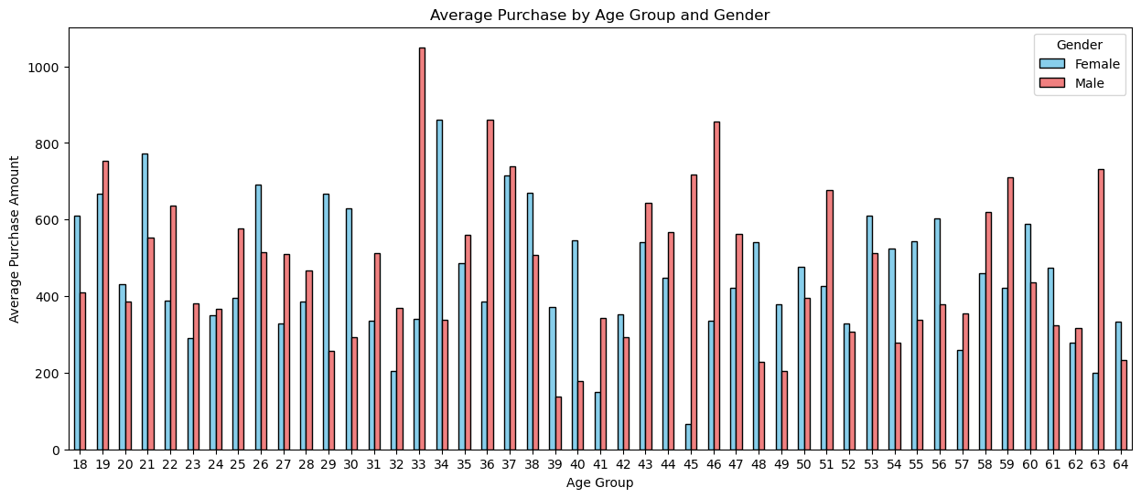
How does customer age and gender influence their purchasing behavior?

Slide 6
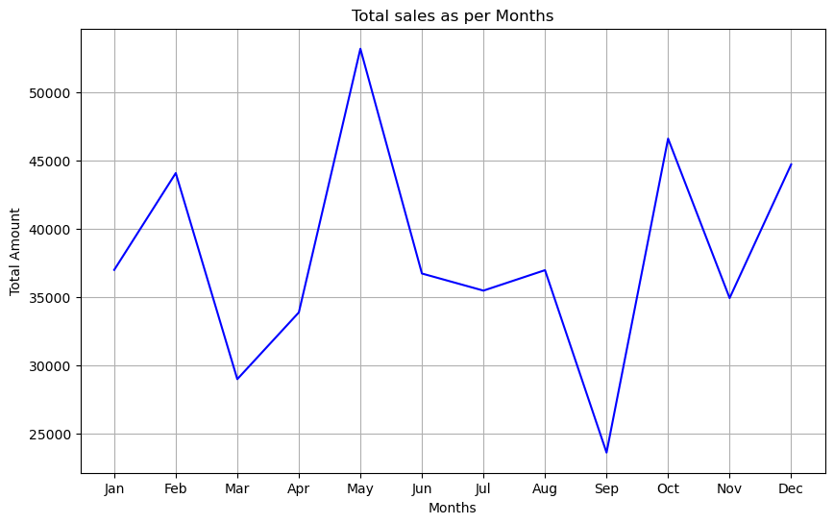
Are there discernible patterns in sales across different time periods?

Slide 7
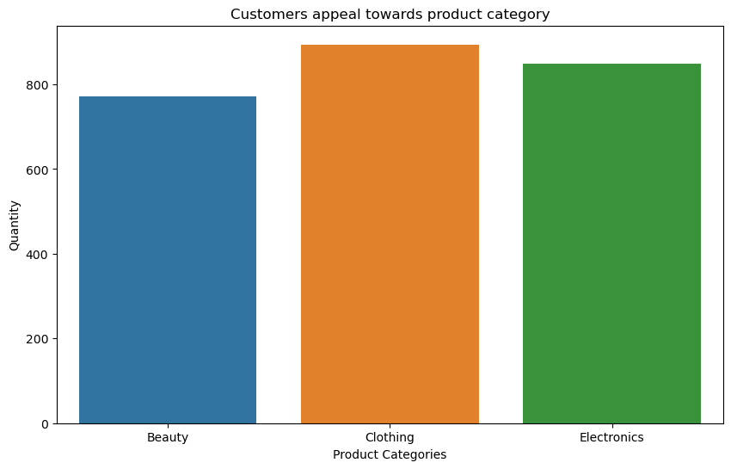
Which product categories hold the highest appeal among customers?

Slide 8
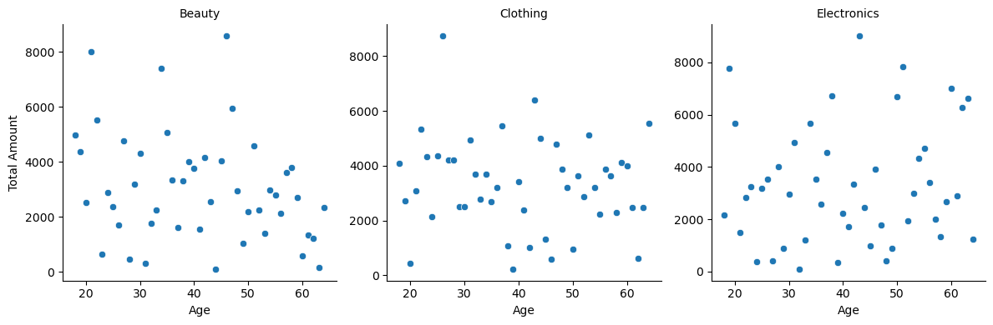
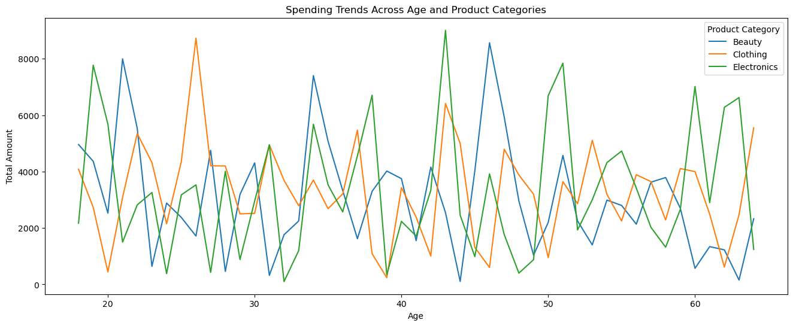
What are the relationships between age, spending, and product preferences?

Slide 9
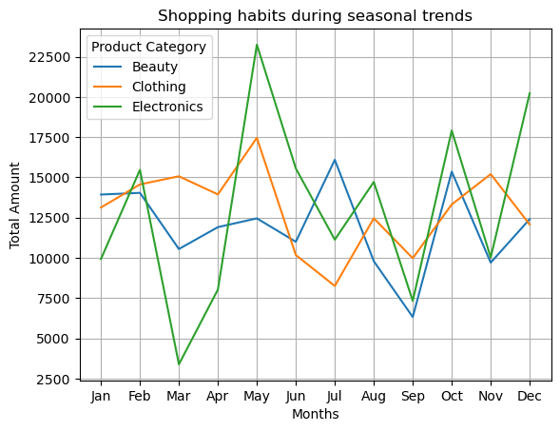
How do customers adapt their shopping habits during seasonal trends?

Slide 10
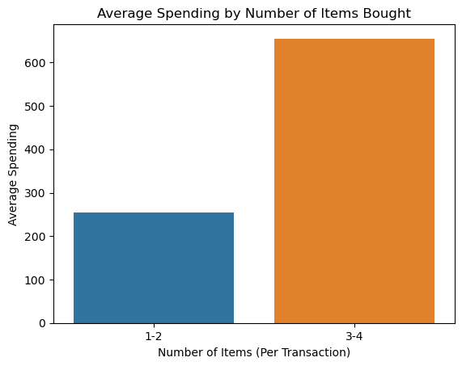
Are there distinct purchasing behaviors based on the number of items bought per transaction?

Slide 11
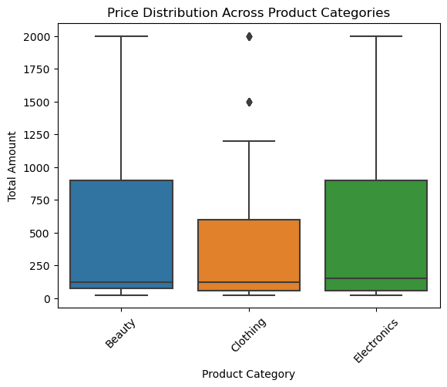
What insights can be gleaned from the distribution of product prices within each category?

Slide 12
Thank You for Watching ..

